Slide 1
R Programming Course
7. Predictive Modeling

Slide 2
R Programming Course
7.1 Hypothesis testing
Example 1: The food label on a cookie bag states that there is at most 2 grams of saturated fat in a single cookie.
In a sample of 35 cookies, it is found that the mean amount of saturated fat per cookie is 2.1 grams.
Assume that the population standard deviation is 0.25 grams.
At 0.05 significance level, can we reject the claim on the food label?

Slide 3
R Programming Course
7.1 Hypothesis testing - continued
The elements about a population that are more often tested are:
1. The population mean (e.g. average pizza delivery time is 30 minutes)
2. The population proportion (e.g. 80% of the voters support the view of the politician)
3. The difference in two proportions means or proportions (e.g. is it true that a greater proportion of males experience the side effects of a drug than females do)

Slide 4
R Programming Course
7.1 Hypothesis testing- continued
A hypothesis test is a technique for using data to validate or invalidate a claim about a population.
For example, a politician may claim that 80% of the people in her state agree with her views on a certain issue.
A Pizza restaurant may claim that they deliver pizzas in 30 minutes or less.
Medical researchers use hypothesis tests all the time to test whether or not a certain drug is effective, to compare a new drug to an existing drug in terms of its side effects.

Slide 5
R Programming Course
7.1 Hypothesis testing- continued
Every hypothesis test contains a set of two opposing statements, or hypotheses, about a population parameter.
The first hypothesis is called the null hypothesis, denoted by H₀, The null hypothesis always states that the population parameter is equal to the claim value.
The opposite of the null hypothesis is the alternative hypothesis, denoted by H_{a} or H₁.
Ref: http://www.dummies.com/how-to/content/how-to-set-up-a-hypothesis-test-null-versus- altern.html

Slide 6


R Programming Course
7.1 Hypothesis testing - continued
Steps in hypothesis testing
Step 1 Frame null and alternate hypothesis
Step 2 Compute the test statistic, z
The z statistic will compare the observed sample mean to an expected population mean.
To obtain a z-score for the entire population with parameters µ and σ, use
If population mean and standard deviation are estimated from a sample parameters (x-bar and s)

Slide 7
R Programming Course
7.1 Hypothesis testing - continued
Steps in hypothesis testing – continued
Step 3 Compute p value and conclude
The test statistic is converted to a conditional probability, p-value. This answers the question, "if the null hypothesis were true, what is the probability of observing the current data or data is more extreme?”
When p-value is =< 0.05, the observed difference is significant.
When p-value is =< 0.01, the observed difference is highly significant.

Slide 8
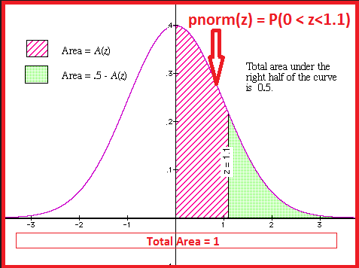
R Programming Course
7.1 Hypothesis testing - continued
Hypothesis testing – continued

Slide 9

R Programming Course
7.1 Hypothesis testing - continued
Solution:
Here the null hypothesis (H₀) is µ ≤ 2
N = 35; sample mean = 2.1 gm;
Population std. deviation = 2.1 gm;
Population mean = 2.0 gm
We use the pnorm function to compute the upper tail of the test statistic.
As it turns out to be less than the 0.05 significance level, we reject the null hypothesis that is H₀: µ ≤ 2

Slide 10
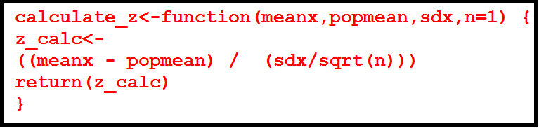
R Programming Course
7.1 Hypothesis testing - continued
Example 2:
The customer accounts of a certain departmental store have an average balance of Rs. 12000 and a standard deviation of Rs. 4000. Assuming that the account balances are normally distributed,
What percentage of accounts has balance Rs.15000?
What proportion of accounts have balance ranging from Rs 10000 to Rs. 15000?
Solution: We first write a function to compute z score.

Slide 11
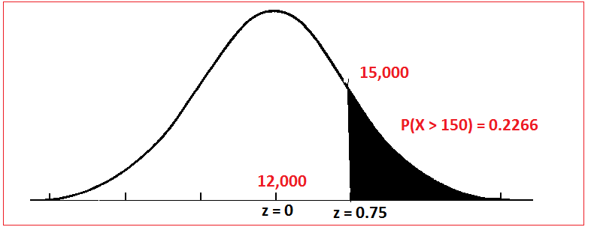
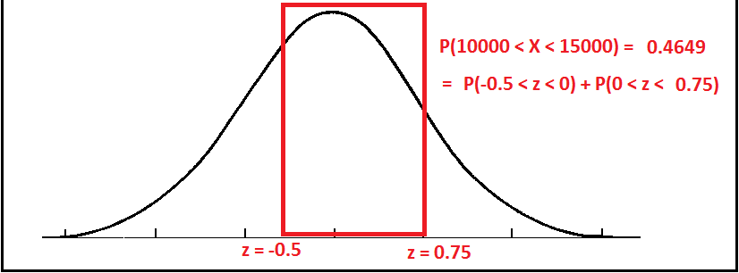
R Programming Course
7.1 Hypothesis testing - continued
Example 2 – continued:

Slide 12
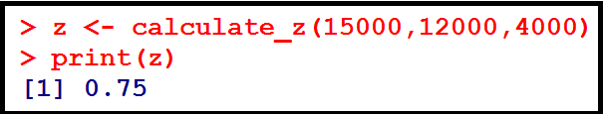

R Programming Course
7.1 Hypothesis testing - continued
Here µ = 12000; σ = 4000 and z = (X - µ )/ σ
We calculate z score by calling the function calculate_z
Then we find the P(z>0.75) by calling the function pnorm and setting the lower.tail = FALSE
22.66 % of the accounts will have balance over Rs.15000.

Slide 13
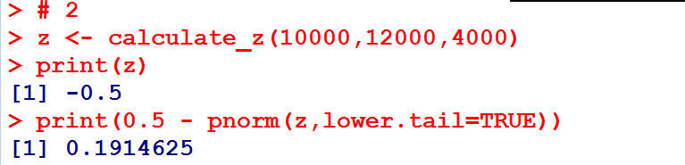
R Programming Course
7.1 Hypothesis testing -continued
Here µ = 12000; σ = 4000 and z = (X - µ )/ σ
We calculate the z score for X = 10000. We calculate z score by calling the function calculate_z
Then we find the P(0.5 < z < 0) by calling the function pnorm and setting the lower.tail = TRUE
22.66 % of the accounts will have balance over Rs.15000.

Slide 14
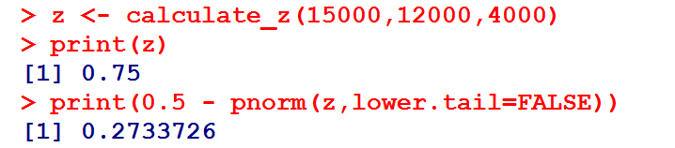
R Programming Course
7.1 Hypothesis testing - continued
Here µ = 12000; σ = 4000 and z = (X - µ )/ σ
We calculate the z score for X = 15000. We calculate z score by calling the function calculate_z with lower .tail = FALSE
Then we find the P(0 < z < 0.75) by calling the function pnorm and setting the lower.tail = FALSE
So, 46.49 % of the accounts will have balance over Rs.15000. (0.1915 + 0.2734 = 0.4649)

Slide 15
R Programming Course
7.2 t Test
A bottle filling machine is set to fill bottles with drinking water to a volume of 500 ml. The actual volume is known to follow a normal distribution.
The manufacturer believes the machine is under filling bottles. A sample of 20 bottles is taken and the volume of liquid is measured.
The results are given in the bottles dataset, which is available here.
bottles.volume <- c(484.11, 459.49, 471.38, 512.01, 494.48, 528.63, 493.64, 485.03, 473.88, 501.59, 502.85, 538.08, 465.68, 495.03, 475.32, 529.41, 518.13, 464.32, 449.08, 489.27)

Slide 16
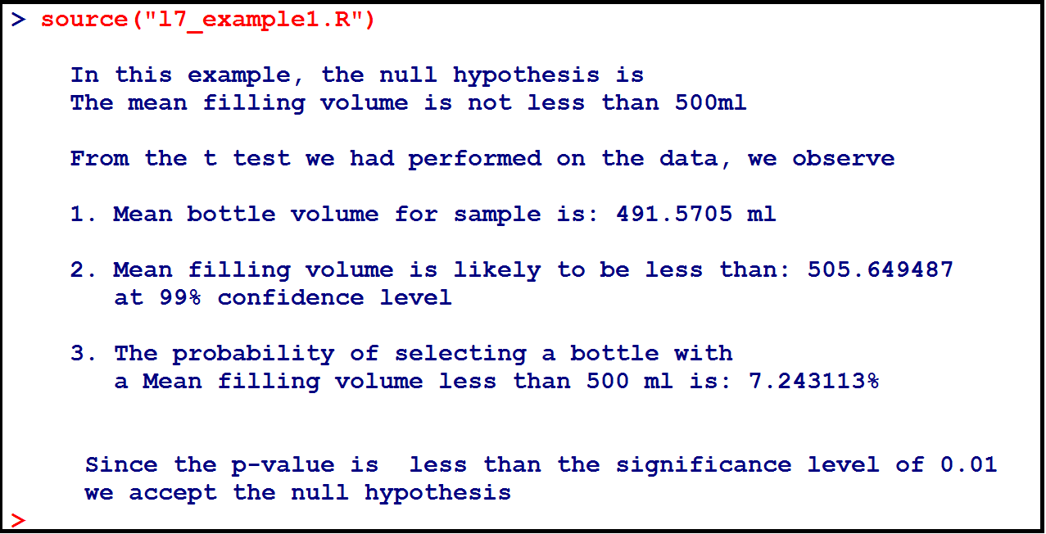
R Programming Course
7.2 t Test - continued
Determine whether the bottles are being consistently under-filled.

Slide 17

R Programming Course
7.2 t Test - continued
Suppose you want to use a one-sample t-test to determine whether the bottles are being consistently under-filled, or whether the low mean volume for the sample is purely the result of random variation.
A one-sided test is suitable because the manufacturer is specifically interested in knowing whether the volume is less than 500 ml.

Slide 18
R Programming Course
7.2 t Test - continued
The test has the null hypothesis that the mean filling volume is equal to 500 ml, and the alternative hypothesis that the mean filling volume is less than 500 ml.
A significance level of 0.01 is to be used.
A t-test is used to test hypotheses about the mean value of a population from which a sample is drawn.
A t-test is suitable if the data is believed to be drawn from a normal distribution, or if the sample size is large.

Slide 19
R Programming Course
7.2 t Test - continued
The function t.test() can be used to perform both one and two sample t-tests on vectors of data.
The function contains a variety of options and can be called as follows:
t.test(x,y = NULL, alternative = c("two sided","less","greater"), mu= 0, paired= FALSE, var.equal= FALSE, conf.level = 0.95)
Here, x is a numeric vector of data values and y is an optional numeric vector of data values.

Slide 20
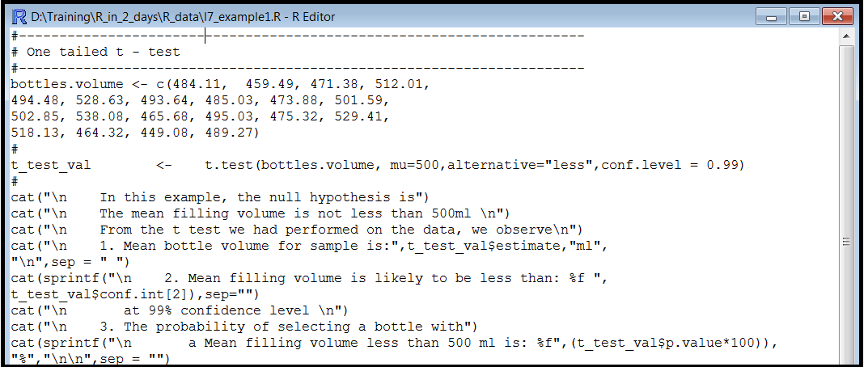
R Programming Course
7.2 t Test - continued
In this R code, the results of the t-test are stored in the variable t_test_val.
We are interested in these attributes of t_test_val:
estimate, p.value and conf.int

Slide 21
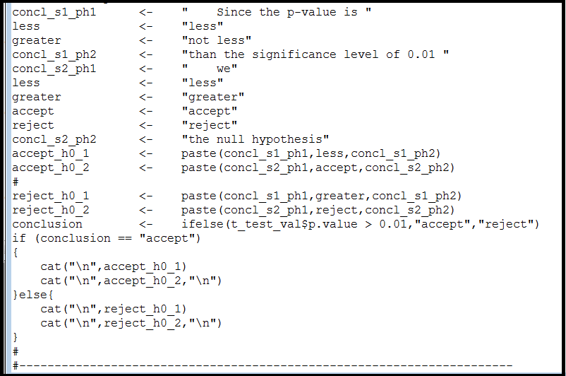
R Programming Course
7.2 t Test - continued

Slide 22
R Programming Course
7.3 Non-Parametric tests
Test if the mean of goals suffered by two football teams over the years is the same.
Team A | 6 | 8 | 2 | 4 | 4 | 5
Team B | 7 | 10 | 4 | 3 | 5 | 6
Solution
The Wilcoxon-Matt-Whitney test (or Wilcoxon rank sum test or Mann-Whitney U- test) is used when you are asked to compare the means of two groups that do not follow a normal distribution.

Slide 23
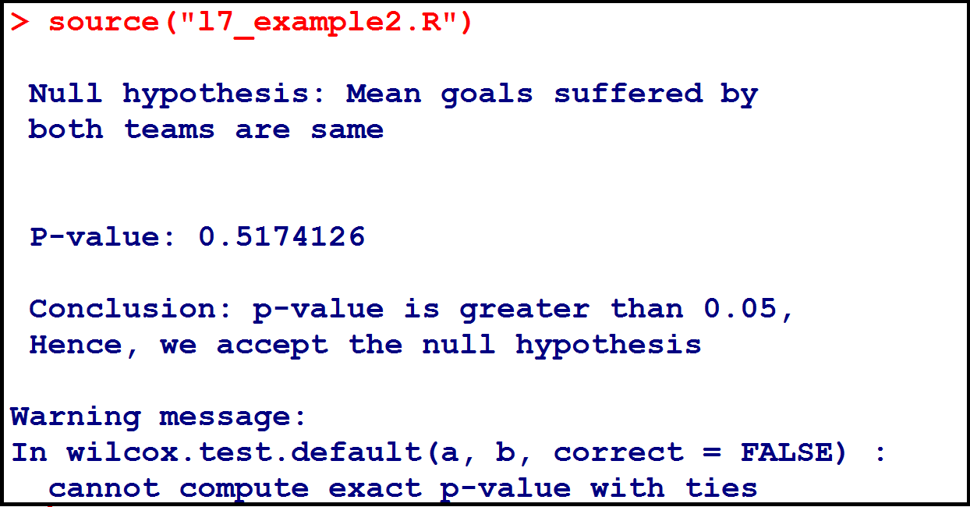
R Programming Course
7.3 Non-Parametric tests - continued

Slide 24
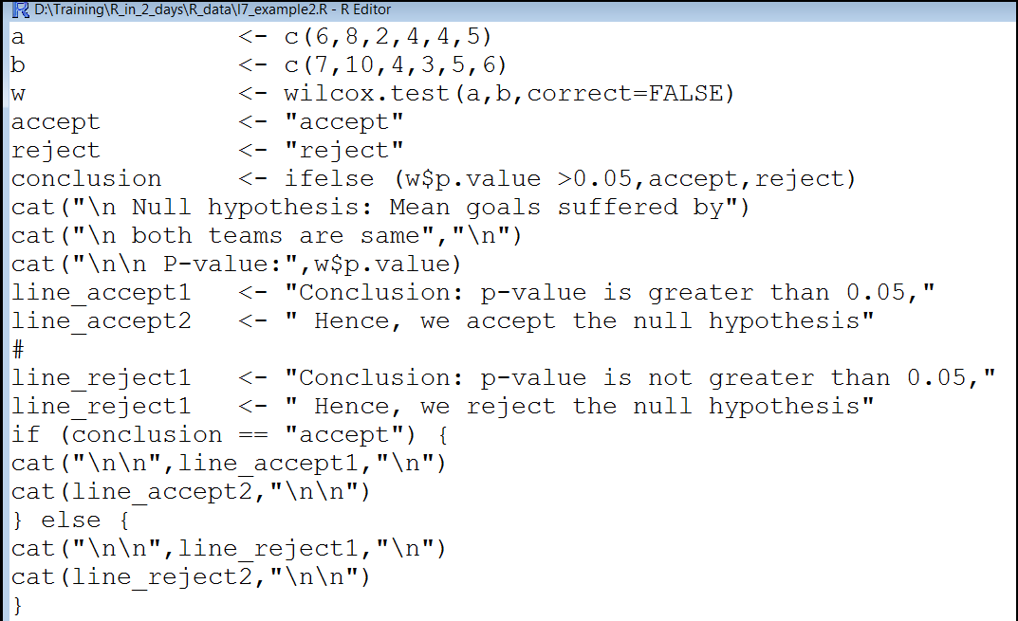
R Programming Course
7.3 Non-Parametric tests - continued

Slide 25
R Programming Course
7.3 Non-Parametric tests - continued
Parametric test
If the information about the population is completely known by means of its parameters then statistical test is called parametric test.
Eg: t-test, f-test, z-test,ANOVA
If there is no knowledge about the population or parameters, but still it is required to test the hypothesis of the population. Then it is called non-parametric test.
Eg: Mann-Whitney, Rank sum test, Kruskal-Wallis test

Slide 26
R Programming Course
7.3 Non-Parametric tests - continued
Parametric test – continued
Non-parametric statistics is a statistical method wherein the data is not required to fit a normal distribution.
Non-parametric statistics uses data that is often ordinal, meaning it does not rely on numbers, but rather a ranking or order of sorts.

Slide 27
R Programming Course
7.4 Chi- Square test
Example 3:
You have three groups based on age (under 45, between 45 and 59 and over 60) and you have nominal data for each group - the frequency of regular health check up (yearly, occasionally, never).
Find out whether the outcomes for the two groups were statistically equal.
Test the hypothesis whether the frequency of the medical check-up is independent of the age group at 0.05 significance level.
You tally the frequency of medical check ups with the age group in the following table, contingency table of the two variables.

Slide 28
R Programming Course
7.4 Chi- Square test - continued
Age | Frequency of regular medical check ups
 | Yearly | Occasionally | Never
Under 45 | 91 | 90 | 51
45 – 59 | 150 | 200 | 155
60 and over | 109 | 198 | 172
H₀: Medical check-up is independent of the age group at 0.05 significance level
H₁: Medical check-up is dependent of the age group at 0.05 significance level

Slide 29
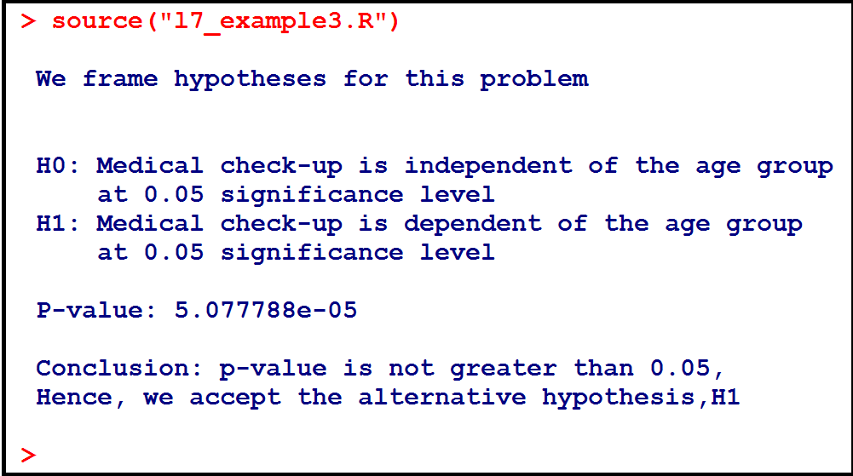
R Programming Course
7.4 Chi- Square test - continued

Slide 30
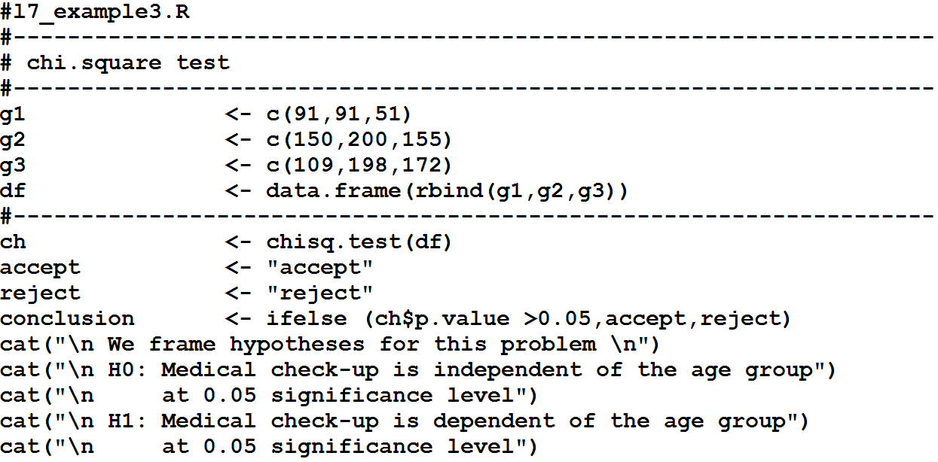
R Programming Course
7.4 Chi- Square test - continued
The first part of the R script l7_example3.R

Slide 31
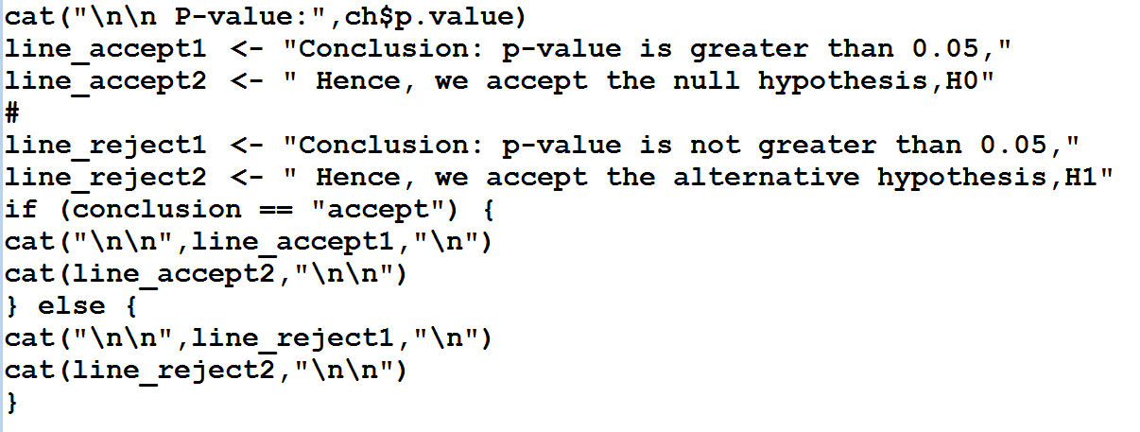
R Programming Course
7.4 Chi- Square test - continued
The second part of the R script l7_example3.R

Slide 32

R Programming Course
7.4 Chi- Square test - continued
Chi-square is a statistical test commonly used to compare observed data with data we would expect to obtain according to a specific hypothesis.
Let the probabilities of various classes in a distribution be p₁, p_{2, ...} p_{k} with observed frequencies m₁, m_{2, ...} m_{k}.
This quantity is therefore a measure of the deviation of a sample from expectation, where N is the sample size.

Slide 33
R Programming Course
7.4 Chi- Square test - continued
Arguments for chisq.test()
X | a numeric vector or matrix x and y can also both be factors
y | a numeric vector; ignored if x is a matrix. If x is a factor, y should be a factor of same length
correct | a logical indicating whether to apply continuity correction when computing the test statistic for 2 by2 tables; one half is subtracted from all |O – E| differences; however, the correction will not be bigger than the differences themselves. No correction is done if simulate.p.value = TRUE.
p | a vector of probabilities of the same length of x.
rescale.p | a logical scalar; if TRUE then p is rescaled (if necessary) to sum to 1. If rescale.p is FALSE and p does not sum to 1, an error is given.
simulate.p.value | a logical indicating whether to compute p-values by Monte Carlo simulation.
B | an integer specifying the number of replicates used in the Monte Carlo test.

Slide 34
R Programming Course
7.4 Chi- Square test - continued
The function chisq.test is used for test of independence and goodness of fit.
If "x" is a 2-D table, array, or matrix, then it is assumed to be a contingency table of frequencies, and a test of independence will be done.
The correct = TRUE option applies the Yates continuity correction when "x" is a 2 X 2 table. Set this to FALSE, if the correction is not desired.
For the goodness of fit test, set "p" equal to the null hypothesized proportions or probabilities for each of the categories represented in the vector "x".

Slide 35
R Programming Course
7.4 Chi- Square test - continued
A survey is conducted to study the student's smoking habits. There are four proper responses in the survey: "Heavy","Regularly","Occasionally" and "Never". The smoking data is multinominal. (Data taken from the built-in data set survey available in the library MASS)
The frequency distribution is given below for the smoking data.
As per the campus smoking statistics, we have
Heavy | Never | Occasionally | Regularly
11 | 189 | 19 | 17

Slide 36
R Programming Course
7.4 Chi- Square test - continued
As per the campus smoking statistics, we have
Determine whether the sample data in survey supports it at 0.05 significance level.
Heavy | Never | Occasionally | Regularly
4.5 % | 79.5 % | 8.5 % | 7.5 %

Slide 37
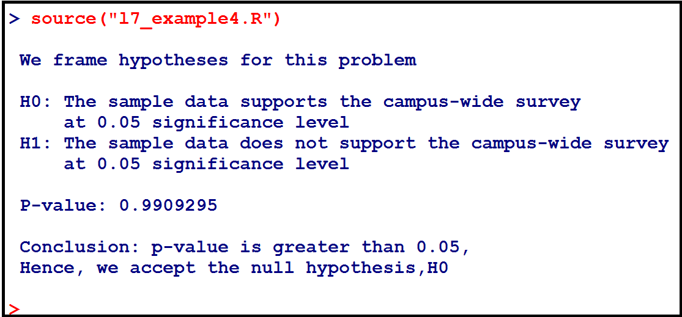
R Programming Course
7.4 Chi- Square test - continued

Slide 38
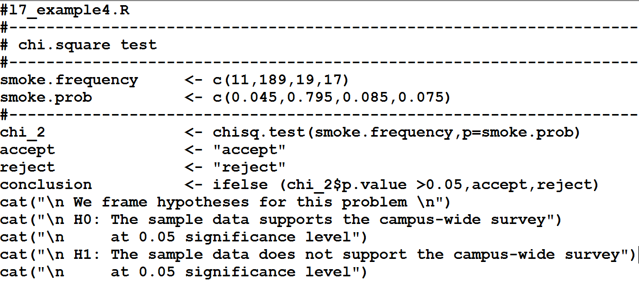
R Programming Course
7.4 Chi- Square test - continued

Slide 39
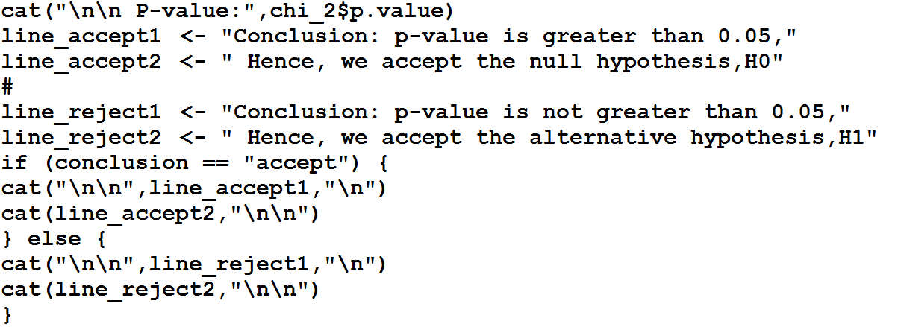
R Programming Course
7.4 Chi- Square test - continued

Slide 40
R Programming Course
7.4 Chi- Square test - continued
Multinomial Goodness of Fit
A population is called multinomial if its data is categorical and belongs to a collection of discrete non-overlapping classes.
The null hypothesis for goodness of fit test for multinomial distribution is that the observed frequency f_{i} is equal to an expected count e_{i} in each category.
Null hypothesis is rejected, if the p-value of the Chi-Squared test statistic is less than a given significance level α.

Slide 41
R Programming Course
7.5 ANOVA
We have raised broods of flies on various flies on various sugars. We measure the size of the individual flies and record the diet for each. Our data file would consist of two columns; one for growth and one for sugar.
Growth | 75 | 72 | 73 | 61 | 67 | 64 | 62 | 63 | 68
Sugar | C | C | C | F | F | F | S | S | S
Growth | 72 | 77 | 78 | 82 | 83 | 78 | 59 | 61 | 63
Sugar | D | D | D | B | B | B | A | A | A
Find out if there is significant effect of diet upon growth.

Slide 42
R Programming Course
7.5 ANOVA - continued
If so, which of these treatments are significantly different from other treatments.
Solution:
We use aov() function to perform analysis of variance test.
When we have a statistically significant effect in ANOVA and an independent variable of more than two levels, we typically want to make follow-up comparisons.
We use Tukey Honest Significant Difference (HSD). for making pairwise comparisons.
We use TukeyHSD(x) function, where x is a linear model object created using aov(formula,data) function.

Slide 43
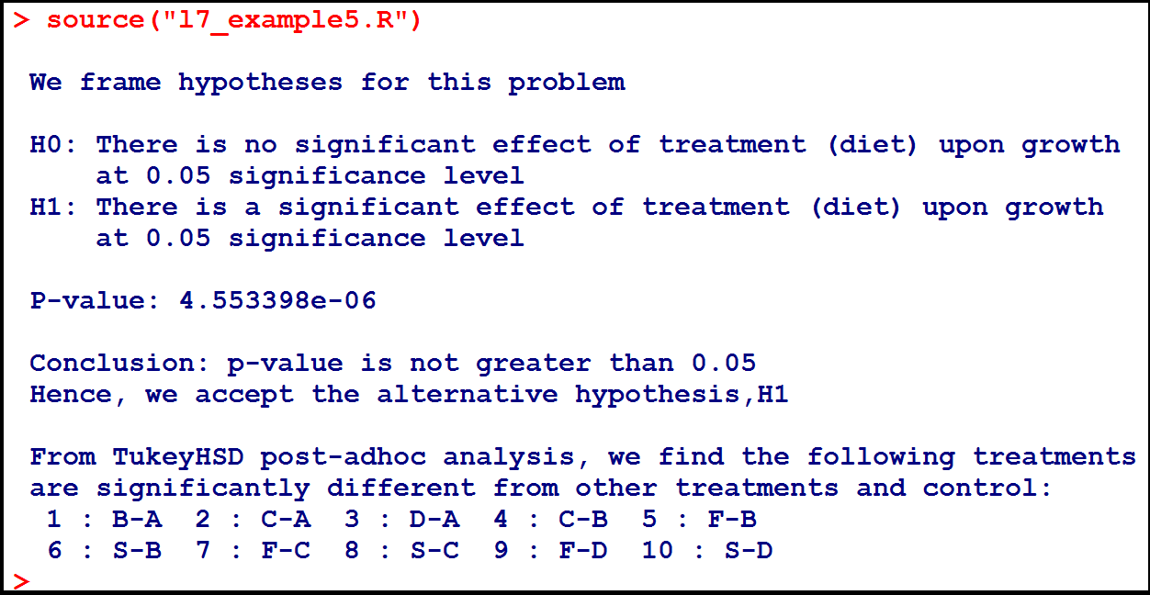
R Programming Course
7.5 ANOVA - continued

Slide 44
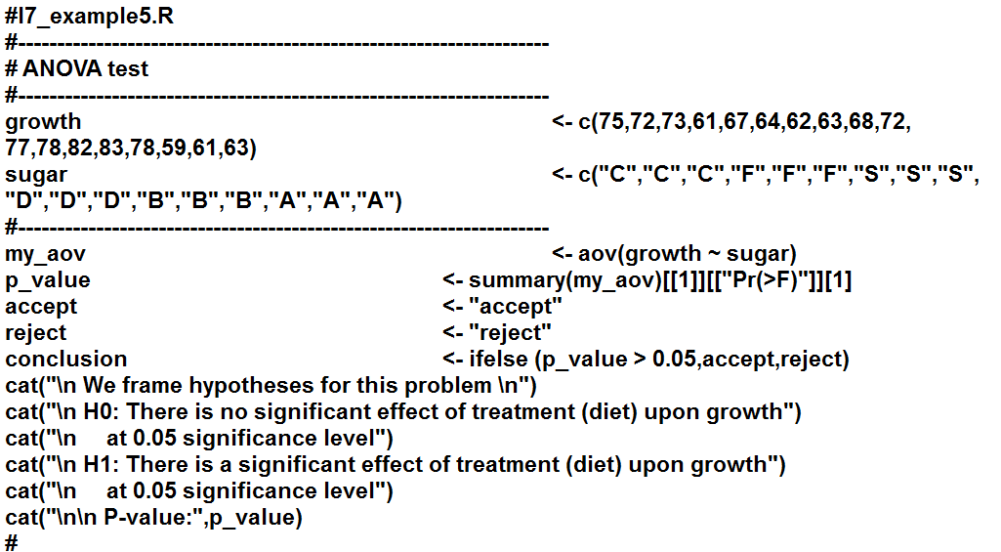
R Programming Course
7.5 ANOVA - continued

Slide 45
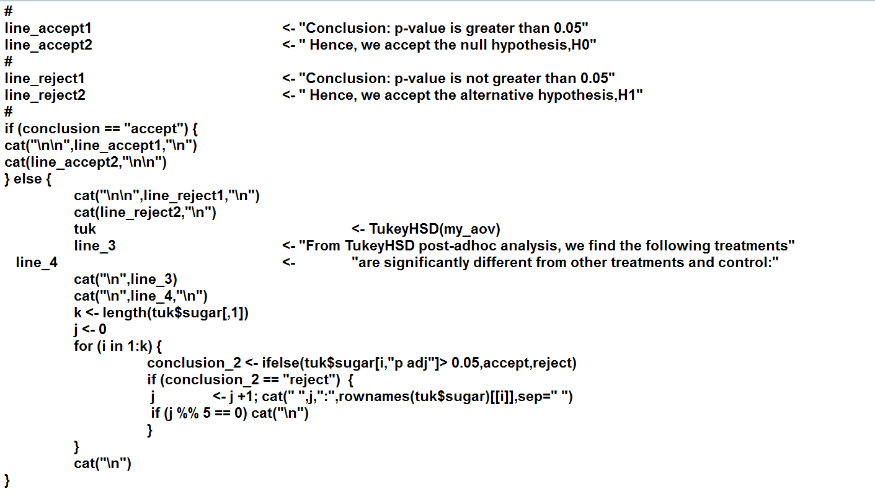
R Programming Course
7.5 ANOVA - continued

Slide 46
R Programming Course
7.5 ANOVA - continued
Like the two-sample t-test, ANOVA lets us test hypotheses about the mean of a dependent variable across different groups.
While the t-test is used to compare the means between two groups, ANOVA is used to compare means between 3 or more groups.
1 One-way ANOVA involves single independent variable
2. Two-way ANOVA involves two or more independent variables
The null hypothesis for ANOVA is that the mean is the same for all groups. The alternative hypothesis is that the mean is not the same for all groups.

Slide 47
R Programming Course
7.5 ANOVA - continued
The ANOVA test procedure produces an F-statistic, which is used to calculate the p-value. If p <0.05, we reject the null hypothesis.
We can then conclude that the mean of the dependent variable is not the same for all groups.
With ANOVA, if the null hypothesis is rejected, then we only know that at least 2 groups are different from each other.
In order to determine which of the two groups are different from which, post-adhoc t-tests (eg. Tukey HSD) are performed.

Slide 48
R Programming Course
7.6 Monte Carlo Simulation
There is an interesting article in the website “Frontline Solvers – Developers of the Excel Solver” about a Business Planning sample using Monte Carlo Simulation.
(http://www.solver.com/monte-carlo-simulation-example)
You, as a marketing manager of a firm are planning to introduce a new product. You need to estimate the first year profit from this product, which will depend on:
Sales volume in units
Price per unit
Unit Cost
Fixed Cost

Slide 49
R Programming Course
7.6 Monte Carlo Simulation
Net profit will be calculated as Net Profit = Sales Volume * (Selling Price – Unit Cost) – Fixed Cost.
Fixed costs (for overhead, advertising, etc.) are known to be $120,000.
But other factors all involve some uncertainty. Sales volume (in units) can over quite a range, and the selling price per unit will depend on competitor actions.
Unit costs will also vary depending on vendor prices and production experience.

Slide 50
R Programming Course
7.6 Monte Carlo Simulation - continued
Uncertain variables
To build a risk analysis model, you must identify the uncertain variables – also called random variables. While there’s some uncertainty in almost all variables in a business model, we want to focus on variables where the range of values is significant.
Sales and Price
Based on the market research, you believe that there are equal chances that the market will be Slow, OK or Hot.
In the “Slow market” scenario, you expect to sell 50,000 units at an average selling price of $11 per unit.

Slide 51
R Programming Course
7.6 Monte Carlo Simulation - continued
In the “OK market” scenario, you expect to sell 75,000 units at an average selling price of $10 per unit.
In the “Hot market” scenario, you expect to sell 100,000 units at an average selling price of $8 per unit. In this scenario, your competitors will push your price down.
Unit Cost
Another uncertain variable is unit cost. Your firm’s production manager advises you that unit costs may vary anywhere between $5.50 to $7.50, with a most likely cost of $6.50. In this case, the most likely cost is also the average cost.

Slide 52
R Programming Course
7.6 Monte Carlo Simulation - continued
Uncertain Functions
Net Profit
We now identify uncertain functions – also called functions of a random variable.
Since Sales volume and Selling Price and Unit cost are all uncertain variables, the net profit calculated based on these variables is an uncertain function.

Slide 53
R Programming Course
7.6 Monte Carlo Simulation - continued
Solution:
Since there are equal chances that the market will be Slow, OK, or Hot, we want to create an uncertain variable that selects among these three possibilities by generating a random number – say 1 or 2 or 3 – with equal probability.
We associate 1 with “Slow Market” state, 2 with “OK market” state and 3 with “Hot market” state.
We generate this number easily by using the R function – “sample” and then base the Sales Volume and Selling Price of this uncertain variable.

Slide 54
R Programming Course
7.6 Monte Carlo Simulation - continued
Solution continued:
Unit cost may vary anywhere from $5.50 to $7.50, with a most likely cost of $6.50. We use triangular distribution to generate this variable.
In probability theory and statistics, the triangular distribution is a continuous probability distribution with a lower limit a, upper limit b and mode c, where a < b and a ≤ c ≤ b.
We install “triangle” package first before using the R to solve this problem.

Slide 55
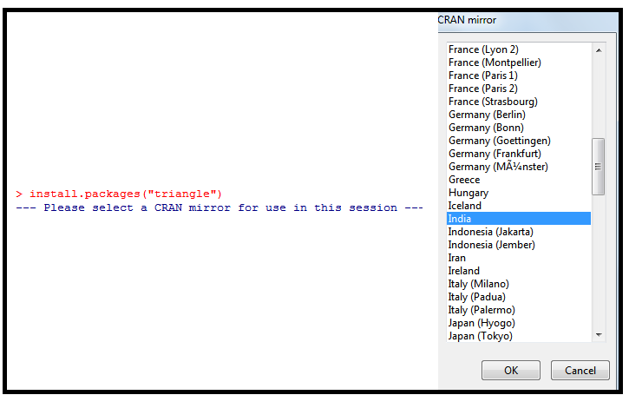
R Programming Course
7.6 Monte Carlo Simulation - continued
Solution continued:

Slide 56
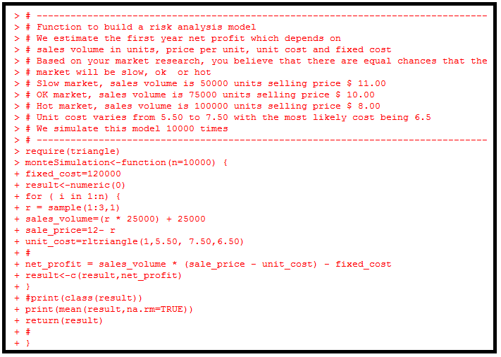
R Programming Course
7.6 Monte Carlo Simulation - continued
Solution continued:

Slide 57
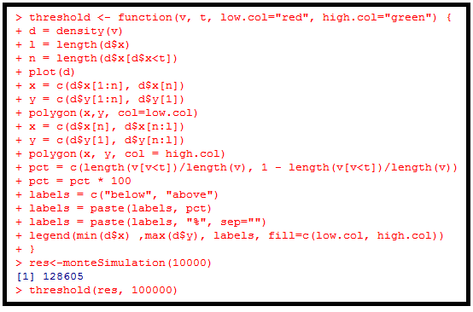
R Programming Course
7.6 Monte Carlo Simulation - continued
Solution continued:

Slide 58
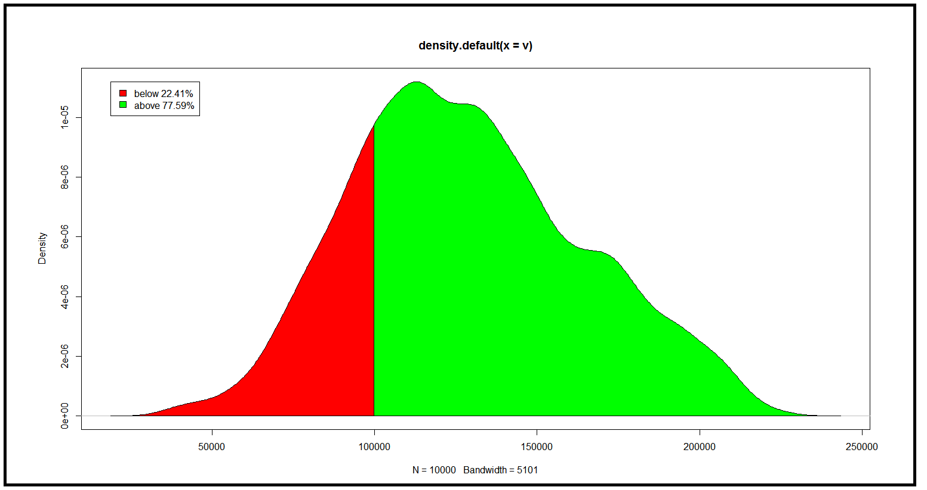
R Programming Course
7.6 Monte Carlo Simulation - continued
Solution continued:
We have observed that the average net profit after 10000 trials is $128,605. From this graph, we see that 77.59% of the trials resulted in the net profit above $100,00 and 22.41% of the trials resulted in the net profit below $100,000.

Slide 59
R Programming Course
7.7 Correlation
Correlation is a method of studying the relationship between two variables.
In statistical analysis, we come across the study of two variables wherein the change in the value of one variable produces a change in the value of another variable. In that case, we say that the variables are correlated or there is a correlation between the two variables.
Two variables may have a positive correlation, a negative correlation or they may be uncorrelated.

Slide 60
R Programming Course
7.7 Correlation - continued
Example:
A tax consultant charges the following rates for his / her clients based on the annual income of the client. Using R draw a scatter plot.
Charges | Annual Income of the client (in million dollars)
50 | 0.25
100 | 1.00
150 | 2.25
200 | 4.00
250 | 6.25
300 | 9.00
350 | 12.25
400 | 16.00
450 | 20.25
500 | 25.00

Slide 61
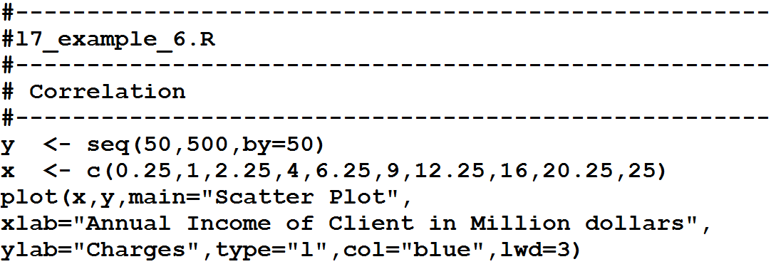
R Programming Course
7.7 Correlation - continued

Slide 62
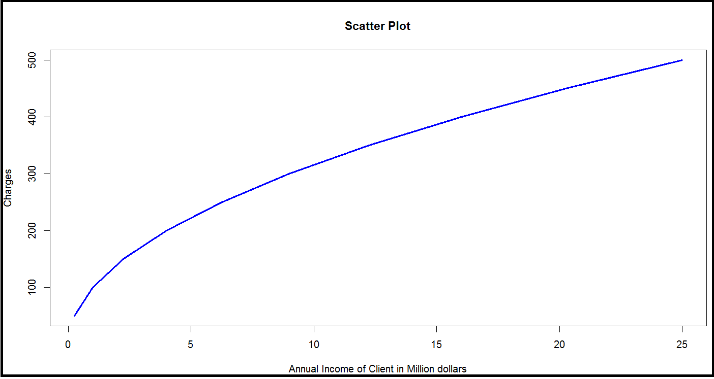
R Programming Course
7.7 Correlation - continued

Slide 63
R Programming Course
7.7 Correlation - continued
The following table gives the age – distribution of the population and the number of unemployed in town.
Find the coefficient of correlation between the mid-values of the age- groups and the percentage of unemployed in different age – constituents.
Age | Number of persons in ‘000 | Number of unemployed
20 – 30 | 40 | 400
30 – 40 | 55 | 1100
40 – 50 | 32 | 960
50 - 60 | 20 | 1600
60 – 70 | 8 | 1600

Slide 64
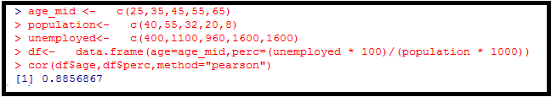
R Programming Course
7.7 Correlation - continued
The Pearson coefficient of correlation between the mid-values of the age-groups and the percentage of unemployed in different age – constituents is approximately, 0.886.

Slide 65
R Programming Course
7.8 Regression
Correlation denotes the association between two quantitative variables.
Regression involves estimating the best equation to summarize the association.
The degree of association is measured by a correlation coefficient, denoted by r. It is sometimes called Pearson's correlation coefficient after its originator and is a measure of linear association.
If a curved line is needed to express the relationship, other and more complicated measures of correlation must be used between the two variables.

Slide 66
R Programming Course
7.8 Regression - continued
Correlation describes the strength of an association between two variables, and is completely symmetrical, the correlation between A and B is the same as the correlation between B and A.
However, if the two variables are related, it means that when one changes by a certain amount the other changes on an average by a certain amount.
If y represents the dependent variable and x the independent variable, this relationship is described as the regression of y on x.

Slide 67
R Programming Course
7.8 Regression - continued
The regression equation representing how much y changes with any given change of x can be used to construct a regression line on a scatter diagram, and in the simplest case this is assumed to be a straight line.
The direction in which the line slopes depends on whether the correlation is positive or negative.
When the two sets of observations increase or decrease together (positive) the line slopes upwards them left to right; when one set decreases as the other increases the line slopes downwards from left to right.

Slide 68
R Programming Course
7.8 Regression - continued
As the line must be straight, it will probably pass through few, if any, of the dots.
Given that the association is well described by a straight line we have to define two features of the line if we are to place it correctly on the diagram.
First one is its distance from the baseline and the other being its slope.
This is explained in the following regression equation, y = a + bx
Regression equation enables us to predict y from x and gives us a better summary of the relationship between the two variables.

Slide 69
R Programming Course
7.8 Regression - continued
R includes a variety of tools for complex modeling, among them:
glm() for generalized linear models
gam() for generalized additive models
lme() and lmer() for linear mixed-effects models
nls() and nlme() for nonlinear models
R functions such as aov(), lm() use a formula interface to specify the variables to be included in the analysis.
The formula determines the model that will be built and tested by the R procedure. The basic format of such a formula is
Response variable ~ explanatory variables

Slide 70
R Programming Course
7.8 Regression - continued
The tilde should be read “is modeled by” or “is modeled as a function of”.
A basic regression analysis would be formulated this way:
y ~ x
… where “x” is the explanatory variable or IV and “y” is the response variable or DV. Additional variables would be added in as follows:
y ~ x + z which would make this z multiple regression with two predictors.
Meaning of the symbols used in the formula is given below:

Slide 71
R Programming Course
7.8 Regression - continued
Example - Find the regression equation between Y1 and X1,X2,X3,X4
Y1 is a measure of success in graduate school
X1 is a measure of intellectual ability
X2 is a measure of work ethic
X3 is a second measure of intellectual ability
X4 is a measure of spatial ability
Y1 | 125 | 158 | 207 | 182 | 196 | 175 | 145 | 144 | 160 | 175
 | 151 | 161 | 200 | 173 | 175 | 162 | 155 | 230 | 162 | 153
X1 | 13 | 39 | 52 | 29 | 50 | 64 | 11 | 22 | 30 | 51
 | 27 | 41 | 51 | 37 | 23 | 43 | 38 | 62 | 28 | 30
X2 | 18 | 18 | 50 | 43 | 37 | 19 | 27 | 23 | 18 | 11
 | 15 | 22 | 52 | 36 | 48 | 15 | 19 | 56 | 30 | 25

Slide 72
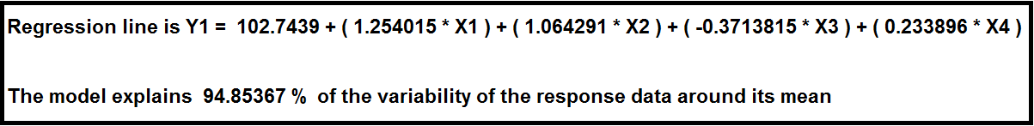
R Programming Course
7.8 Regression - continued
X3 | 25 | 59 | 62 | 50 | 65 | 79 | 17 | 31 | 34 | 58
 | 29 | 53 | 75 | 44 | 27 | 65 | 62 | 75 | 36 | 41
X4 | 11 | 30 | 53 | 29 | 56 | 49 | 14 | 17 | 22 | 40
 | 31 | 39 | 36 | 27 | 20 | 36 | 37 | 50 | 20 | 33

Slide 73
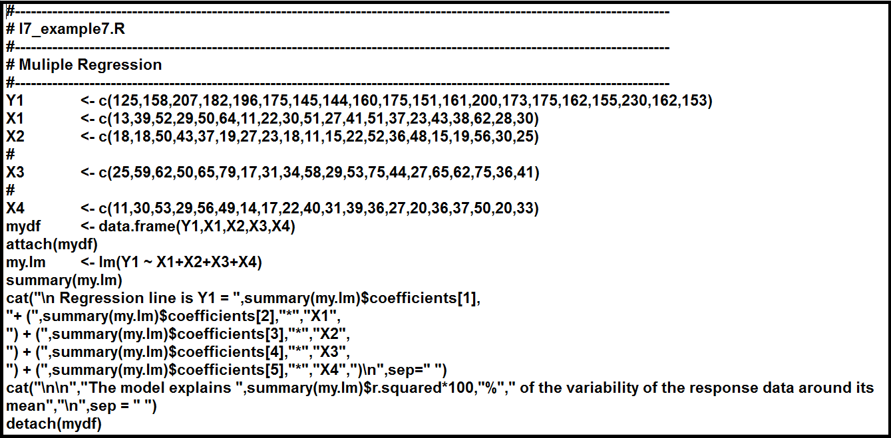
R Programming Course
7.8 Regression - continued

Slide 74
R Programming Course
7.8 Regression - continued
By use of the logistic regression equation of vehicle transmission in the data set mtcars, estimate the probability of a vehicle being fitted with a manual transmission if it has a 120 hp engine and weights 2800 lbs.
Solution
We apply the function glm to a formula that describes the transmission type (am) by the horsepower (hp) and weight (wt). This creates a generalized linear model (GLM) in the binomial family.

Slide 75
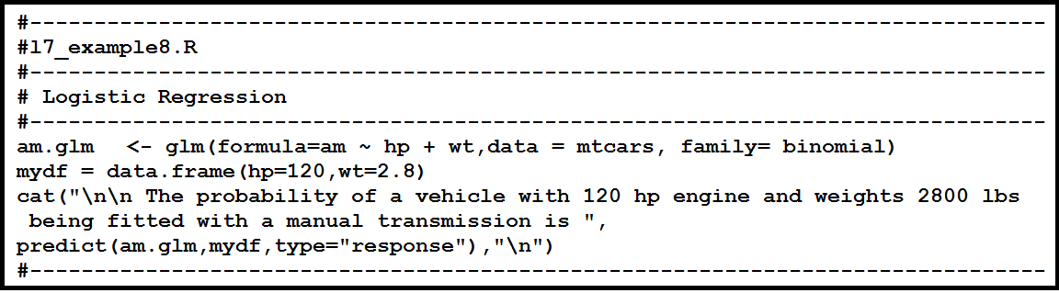
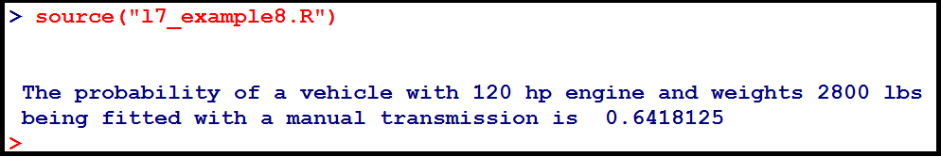
R Programming Course
7.8 Regression - continued
Now we apply the function predict to the generalized linear model am.glm along with mydf. We will have to select response prediction type in order to obtain the predicted probability.

Slide 76
R Programming Course
7.8 Regression - continued
We use the logistic regression equation to predict the probability of a dependent variable taking the dichotomy values 0 or 1.
Suppose x₁,x₂,...x_{p} are independent variables, α and β_{k} (k=1,2,...p) are parameters, and E(y) is the expected value of the dependent variable y, then the logistic regression equation is:
E(y) = 1 / ( 1 + e^{-(α + ∑β}_{k}^{x}_{k}⁾)
For example, in the built-in data set mtcars, the data column am represents the transmission type of the automobile model (0 = automatic, 1 = manual).

Slide 77
R Programming Course
7.8 Regression - continued
With the logistic regression equation, we can model the probability of a manual transmission in a vehicle based on its engine horsepower and weight data.
P(Manual Transmission)
= 1 / ( 1 + e^{-(α + β}₁^{* horse power + β}₂^{*weight)})

Slide 78
R Programming Course
7.9 Clustering
Consider the following data set consisting of the scores of two variables on each of seven individuals:
Subject | A | B
1 | 1.0 | 1.0
2 | 1.5 | 2.0
3 | 3.0 | 4.0
4 | 5.0 | 7.0
5 | 3.5 | 5.0
6 | 4.5 | 5.0
7 | 3.5 | 4.5

Slide 79
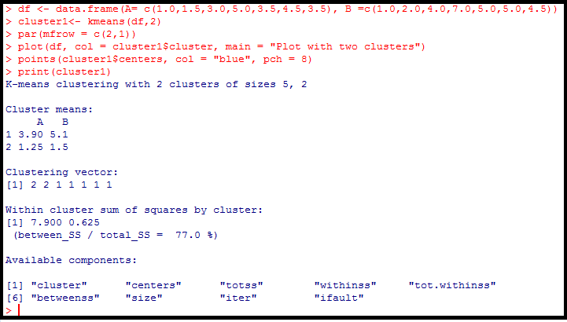
R Programming Course
7.9 Clustering- continued

Slide 80
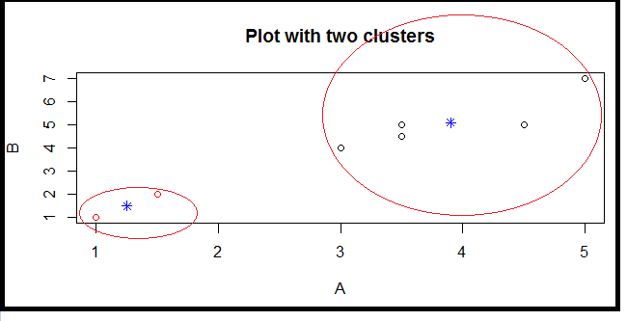
R Programming Course
7.9 Clustering- continued

Slide 81
R Programming Course
7.9 Clustering- continued
This is a prototype-based, partitional clustering technique that attempts find a number of specified clusters (k), which are presented by their centroids (mean).
K-means algorithm proceeds in such a way that the elements are assigned randomly to k clusters and the centroid (mean) is calculated for each cluster.
In the next step, the elements are reassigned in such a manner that it belongs to the cluster with closest centroid.
This process is iterated until two consecutive steps end up in the same assignment of elements.

Slide 82
R Programming Course
7.9 Clustering- continued
In R package, k-means clustering is done using the function kmeans().
kmeans(x, centers, iter.max = 10, nstart = 1, algorithm = c(“Hartigan-Wong”,”Lloyd”,”Forgy”,”MacQueen”), trace= FALSE)
Arguments
x | Numeric matrix of data, or an object that can be coerced to such a matrix
centers | Either the number of clusters, say k or a set of initial (distinct) cluster centers. If a number, a random set of (distinct) rows in x is chosen as the initial centers.
iter.max | The maximum number of iterations allowed
nstart | If centers is a number, how many random set should be chosen
Algothithm | Determines the algorithm to be used. Default is Hartigan-Wong
Trace | A logical value which product the tracing information on the progress of the algorithm, if TRUE

Slide 83
R Programming Course
7.9 Clustering - continued
Clustering is the task of assigning a set of objects into groups (called clusters) so that the objects in the same cluster are more similar (in some sense or another) to each other than to those in other clusters.
A cluster is therefore a collection of objects which are “similar” between them and are “dissimilar” to the objects belonging to other clusters.
Clustering algorithms
Exclusive clustering
Overlapping clustering
Hierarchical clustering
Probabilistic clustering

Slide 84
R Programming Course
7.9 Clustering - continued
The four most used clustering algorithms:
K-means
Fuzzy C-means
Hierarchical clustering
Mixture of Gaussians
Each of these algorithms belongs to one of the clustering types listed above.
K-means is an exclusive clustering algorithm. Fuzzy C-means is an overlapping clustering algorithm.
Hierarchical is obvious and lastly Mixture of Gaussian is a probabilistic clustering algorithm.

Slide 85

R Programming Course

Slide 86
R Programming Course
Activity 1:
Read the file “U08_R_Exercises_v1.pdf“

